Slide 1
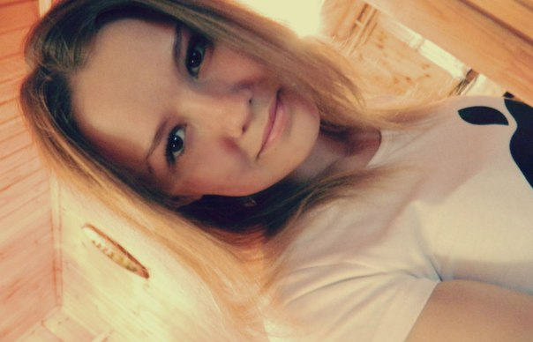
My name is Belova Natasha. I am a student of the 10th form of Russian Shugan School.

Slide 2
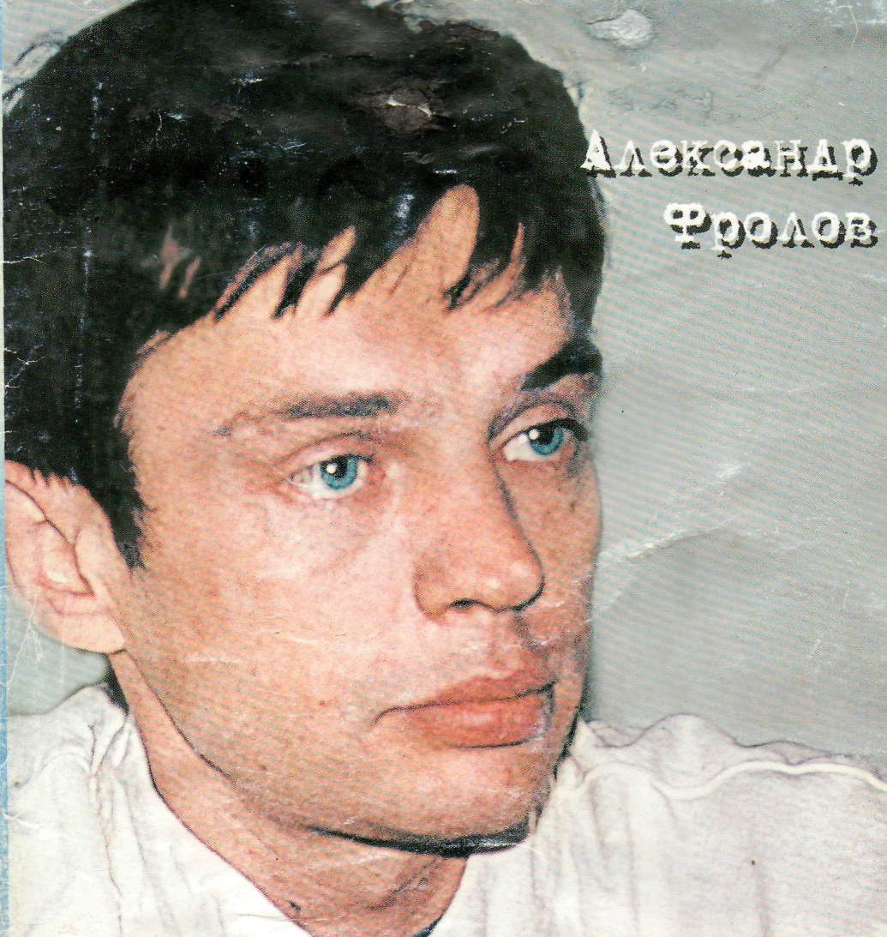
The poet and journalist
Alexander Frolov

Slide 3
Alexander Frolov is the journalist, poet from my settlement Russian Shugan.
The aims of my research are:
To study the life and works of the poet
To popularize the name of A.Frolov
To attract attention to Alexander Frolov’s literary works

Slide 4
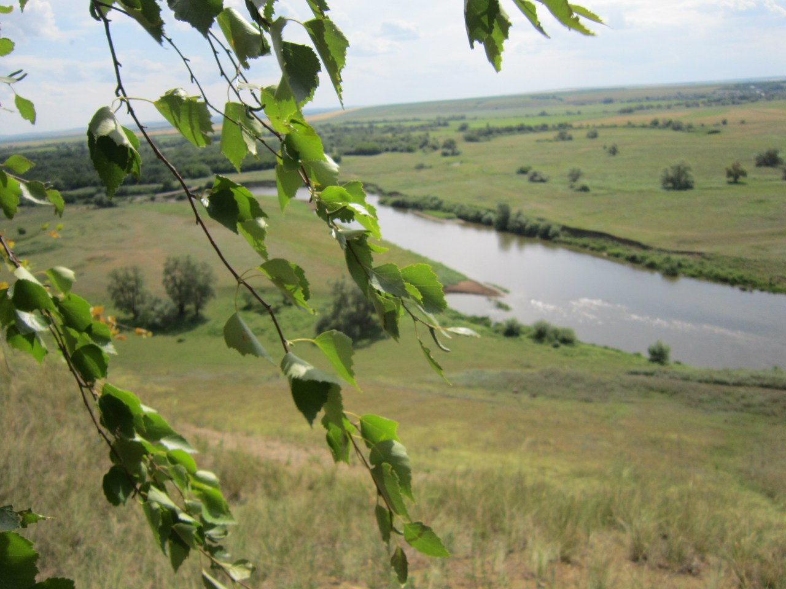
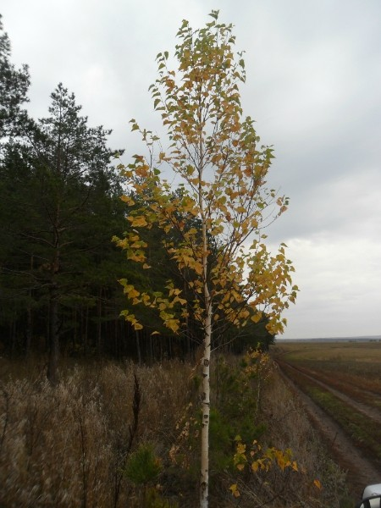
I always admire the beauty of my Motherland – Russian Shugan.

Slide 5
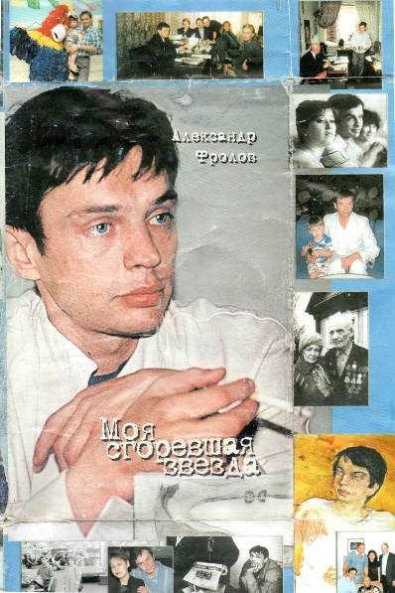
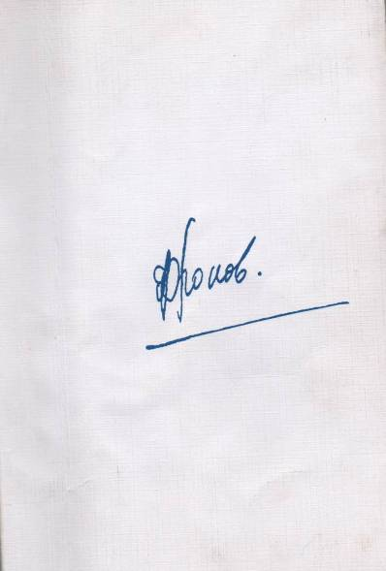
The book was published in 2003.
The circulation was 500 books.

Slide 6
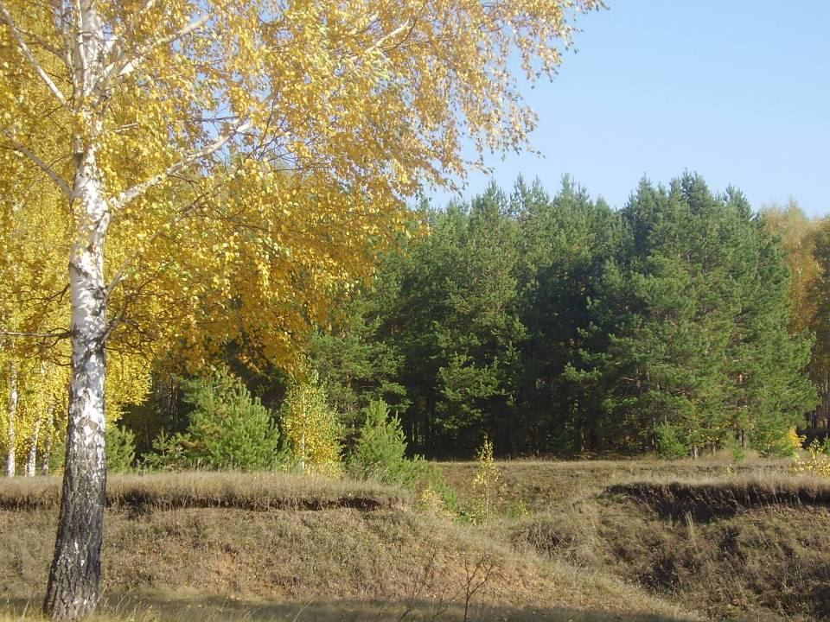
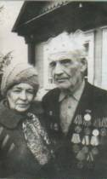
A.Frolov was born on the 29th of February in 1960 in our native village Russian Shugan. His parents were wonderful teachers Zoya Fedorovna and Leonid Fedorovich.

Slide 7
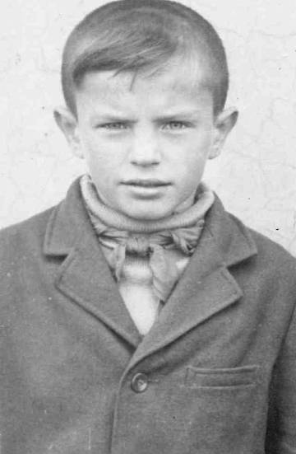
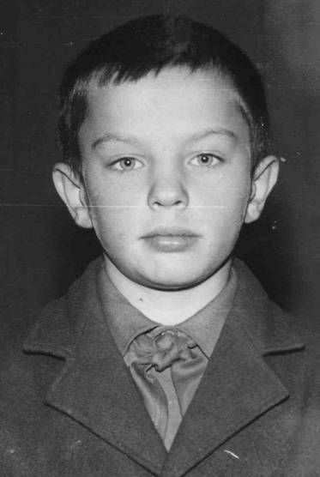
School years

Slide 8
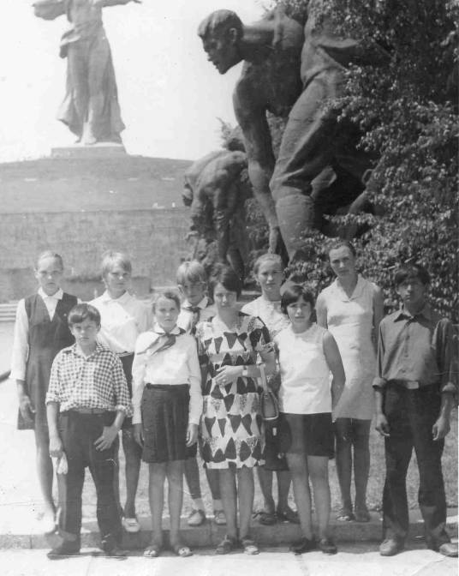


Slide 9
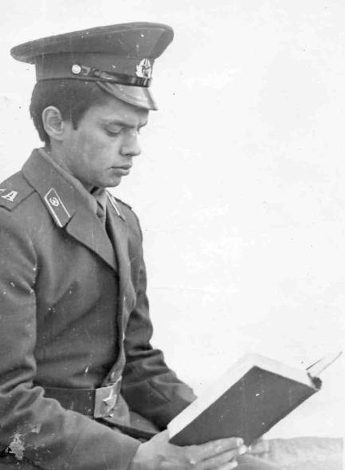
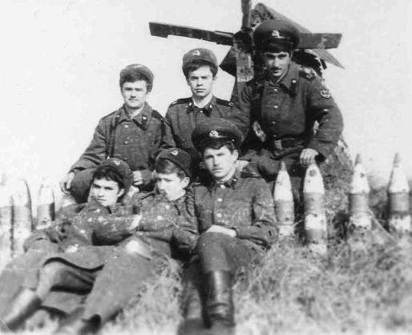
Army

Slide 10
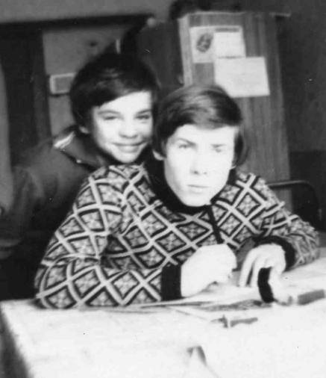
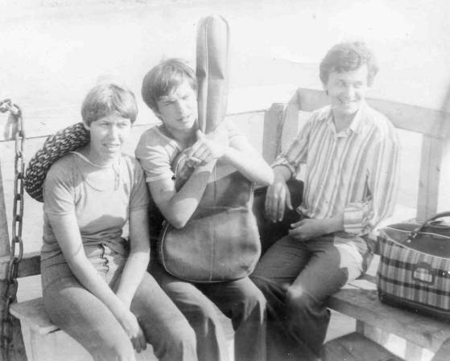
Student life

Slide 11
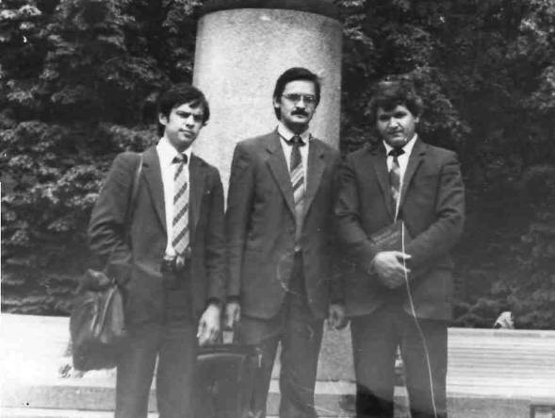
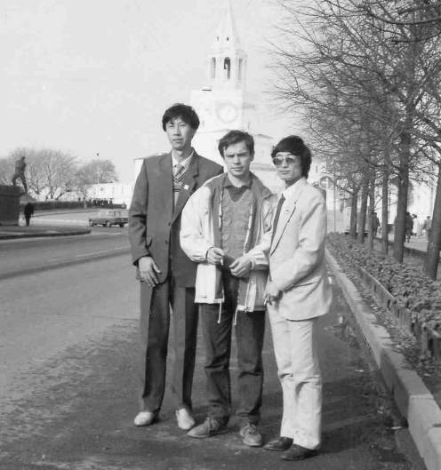
Journalistic work

Slide 12
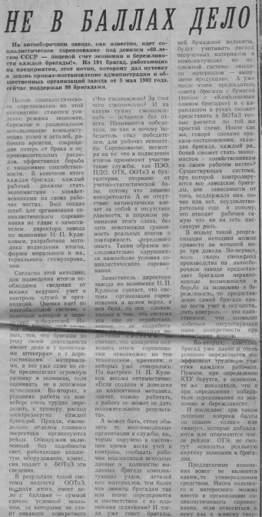
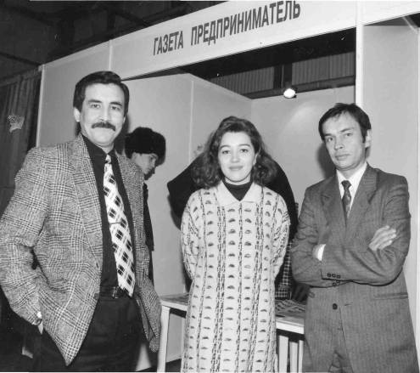
A. Frolov is a correspondent

Slide 13
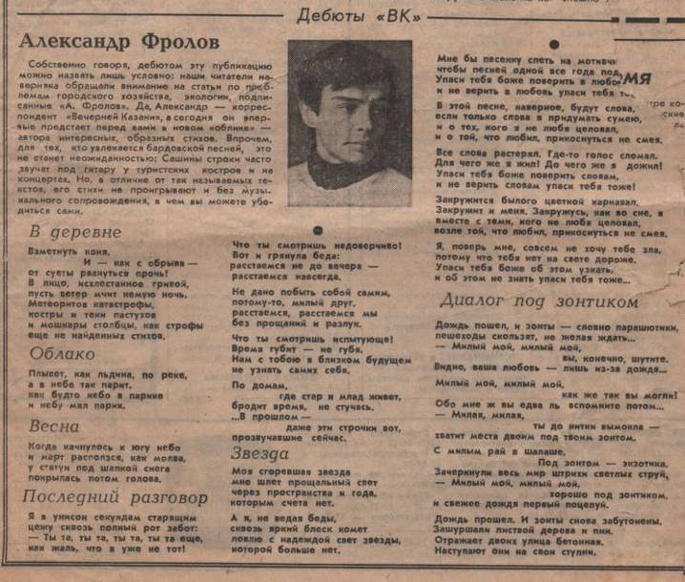
“Vechernyaya Kazan”,1988

Slide 14
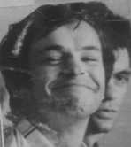
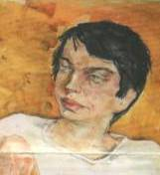

Slide 15

